Slide 1
Arduino – Smart water control system
Present by
m.b. Nadeesha shalom Dias
THE PROJEGECT PROPOCAL presentation
FOR The
HND SOFTWARE ENGINEERING

Slide 2
List of content
Introduce the project
Design diagram
Hardware requirement
Software requirement
Introduce the process
Advantages
Disadvantages
References
Introduce main hardware components

Slide 3
Introduce the project
The project proposals is based on the purpose of watering the plants using a smart system and a brief description of the implementation steps for the proposed system.
Arduino-UNO Board / Development as a Wi-Fi based farmer automation system with various sensors and Android applications.
The main purpose of this is to obtain the soil water level and check the given conditions and when the soil water level falls below the given water level, make an alert in the Android application.
Water can be supplied water manually and automatically after the user / farmer sees the alert.

Slide 4
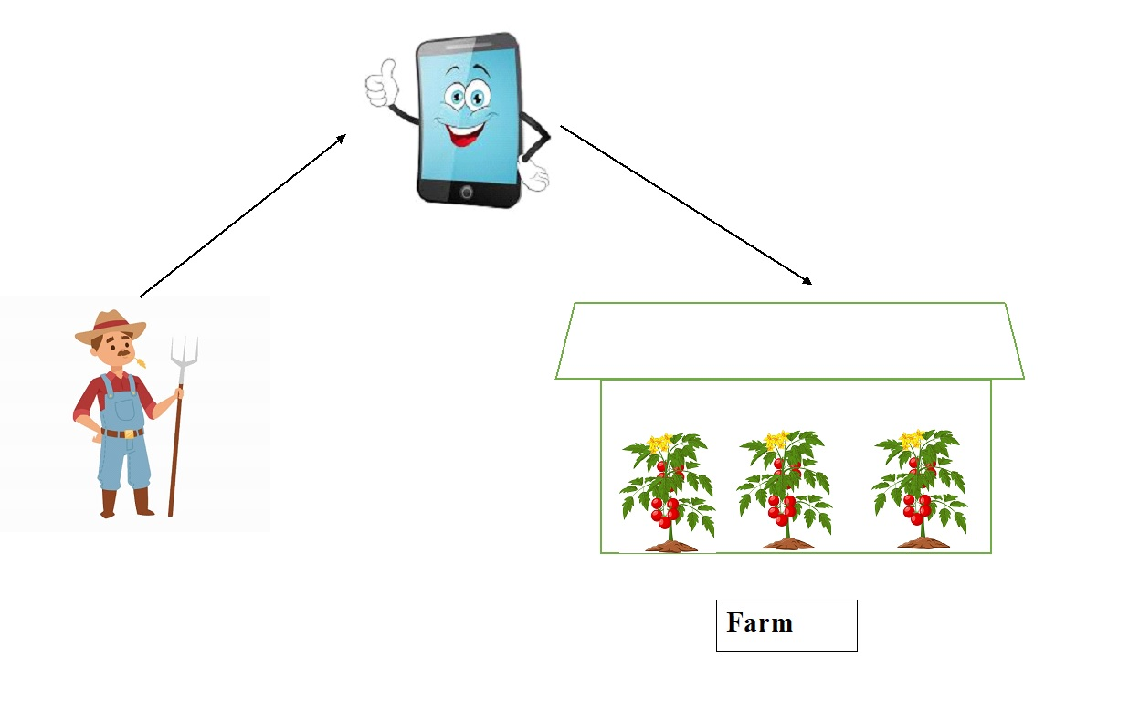
Design diagram
Farmer

Slide 5
Hardware requirement
WIFI router
Water pump
Real-Time Clock
Watering tube
Resistors
9v battery connector with dc jack
9v battery
Arduino Uno R3 board
Bread Board
Nod MCU (esp8266)
Temperature and humidity sensor (DHT-22 sensor)
Soil humidity sensor
Water flow sensor
Ultrasonic sensor
Jumper Wires

Slide 6
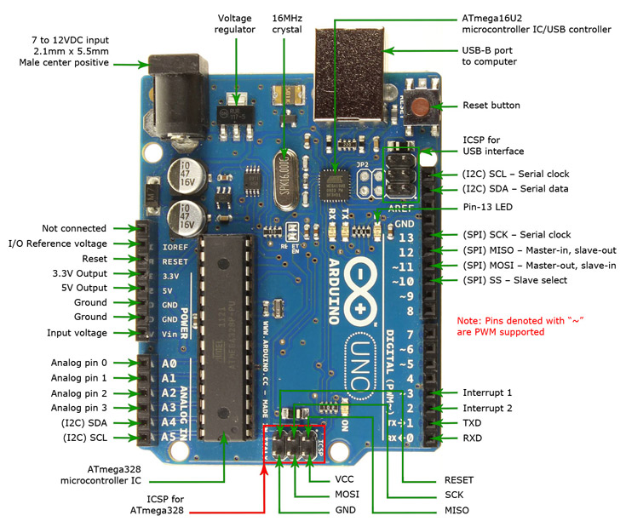
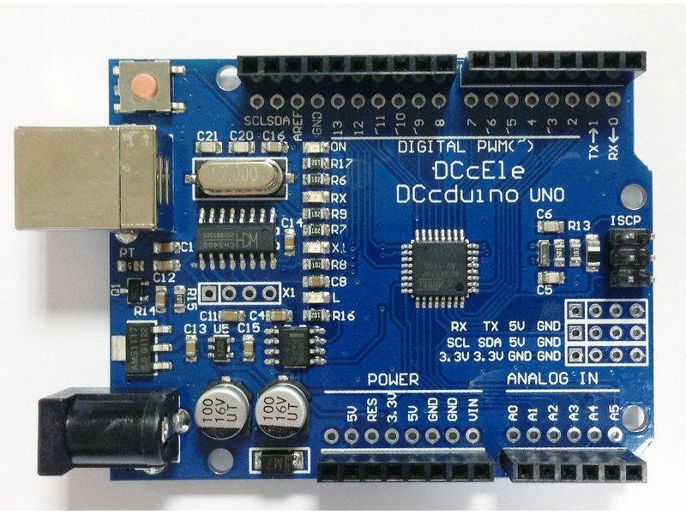
Introduce main hardware components
Arduino uno r3
The board is equipped with sets of digital and analog input/output pins that may be interfaced to various expansion boards and other circuits.
In here I use this for add the all hardware components, and i use this also to control the all hardware's.

Slide 7
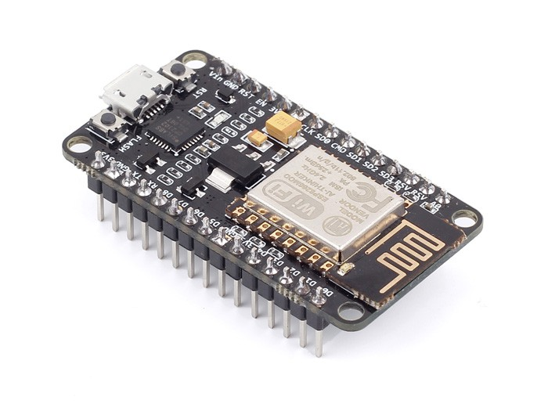
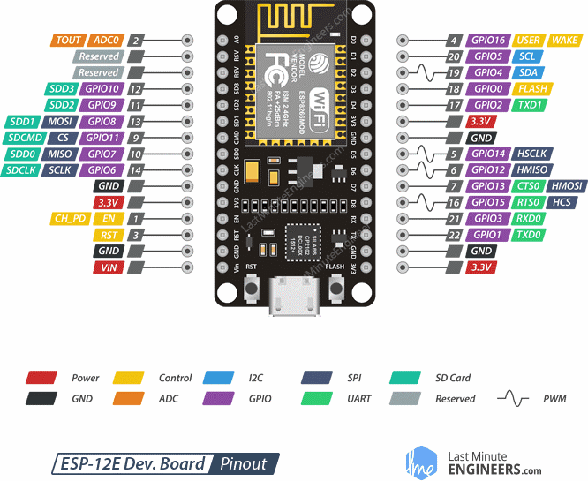
2) Node MCU (esp8166)
The ESP8266 is a low-cost Wi-Fi microchip, with a full TCP/IP stack and microcontroller capability.
In here I use this for connect the all hardware devices with android app via wi-fi.

Slide 8
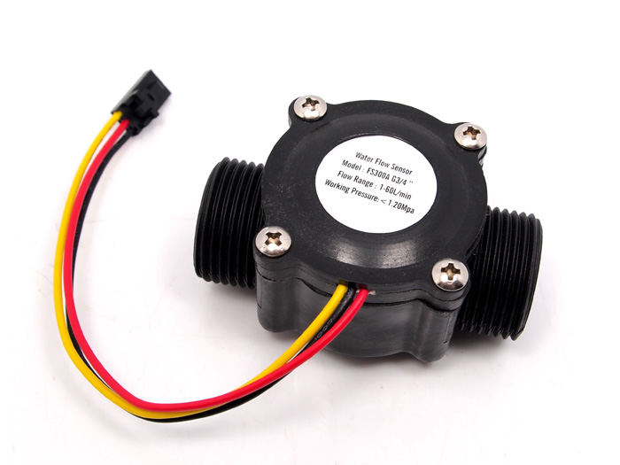
3) Water flow sensor
Measures the rate at which water flows and the amount of water that flows.
The water flow sensor I use this to calculate how much water used the farmer in a day.

Slide 9
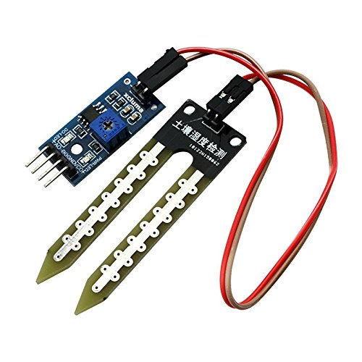
4) Soil moisture sensor
Sensor connected to an irrigation system controller that can measure soil moisture.

Slide 10
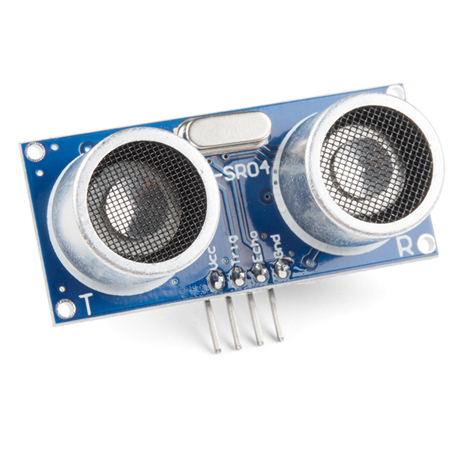
5) Ultrasonic sensor
An ultrasonic sensor is an electronic device that measures the distance of a target object by emitting ultrasonic sound waves, and converts the reflected sound into an electrical signal.
In here I use this for get the water level. And I can be shown the water level in the UI using this.

Slide 11
Software requirement
The table represent the softwares and the programing languages which I use to develop this software.
Software use(IDE) | Programing language
Android SDK | Java
Visual Studio Code | Flutter
MYSQL database | C++
IntelliJ Idea CE
Arduino IDE

Slide 12
Introduce the process
When we consider about the process in this project, the main purpose is control the water with a human and without a human.
When we consider about this project, when the water level goes down than given value the system auto identify whether the soil need water or not.
When the water need to the plants the system send an alert to the android app. then , the farmer if seen that alert he can get an action in the manually mode. in the automatically mode, the system provide the water automatically until equal the given value.
Meanwhile, temperature and humidity are read as a factor. It also notifies the farmer through the Android app.

Slide 13

Advantages
It easy to use the system.
It will save the energy and time.
Convenience.
Also can be used by physically challenged and disabled people.
Complexity is less as only a single mobile is used multiple devices.
There is a feedback path when success command.

Slide 14

Disadvantages
Only works for limited range or short distance.
Cost is high.
Circuit complexity increases as number of devices increase.
It is hard to get it repair.

Slide 15
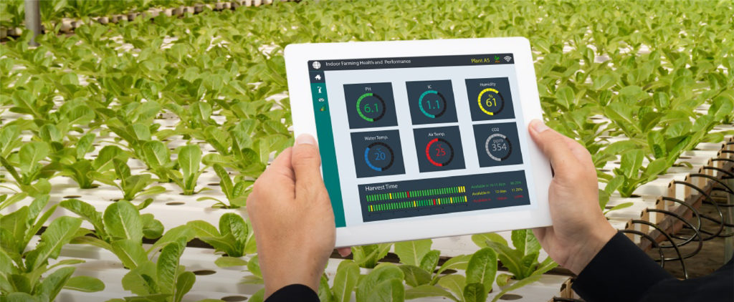
Future works
This system can be further developed over a large area.
This toolkit needs to be further enhanced to prevent unnecessary waste of water resources for cultivation. Then it can be controlled from anywhere in the world.

Slide 16
References
https://www.arduino.cc
https://creately.com/diagram/example/htlepo7i2/UML%20Arduino
https://www.electronicshub.org/arduino-project-ideas

Slide 17
THANK YOU FOR YOUR ATTENTION And Thank you for providing me this opportunity.

